Slide 1
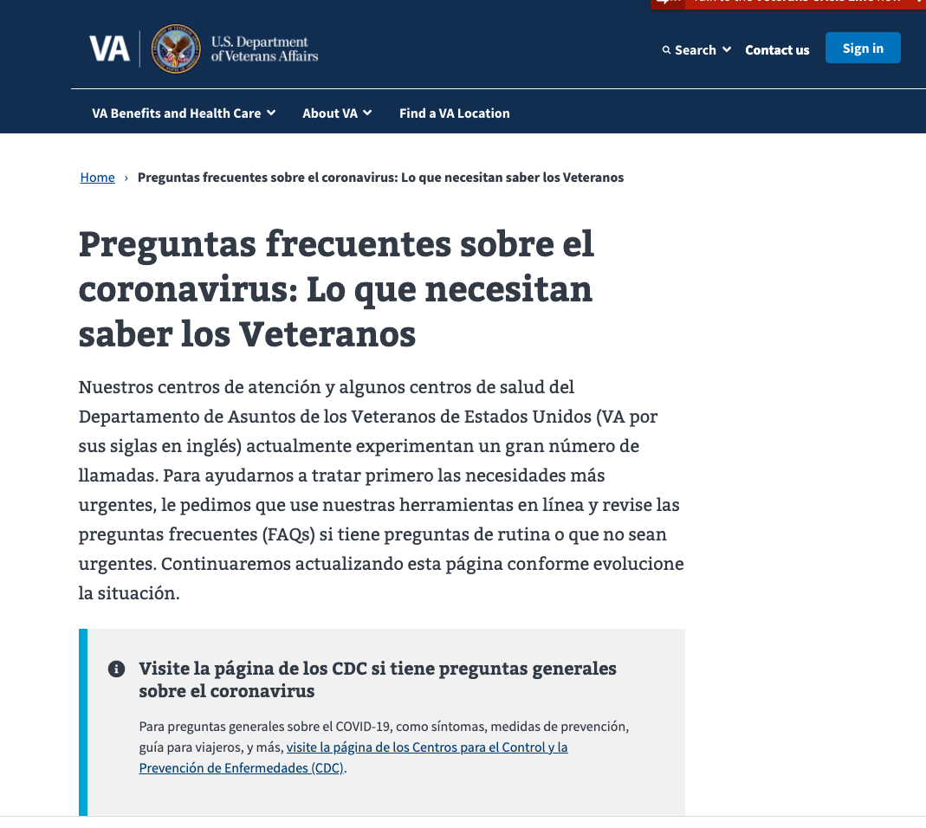
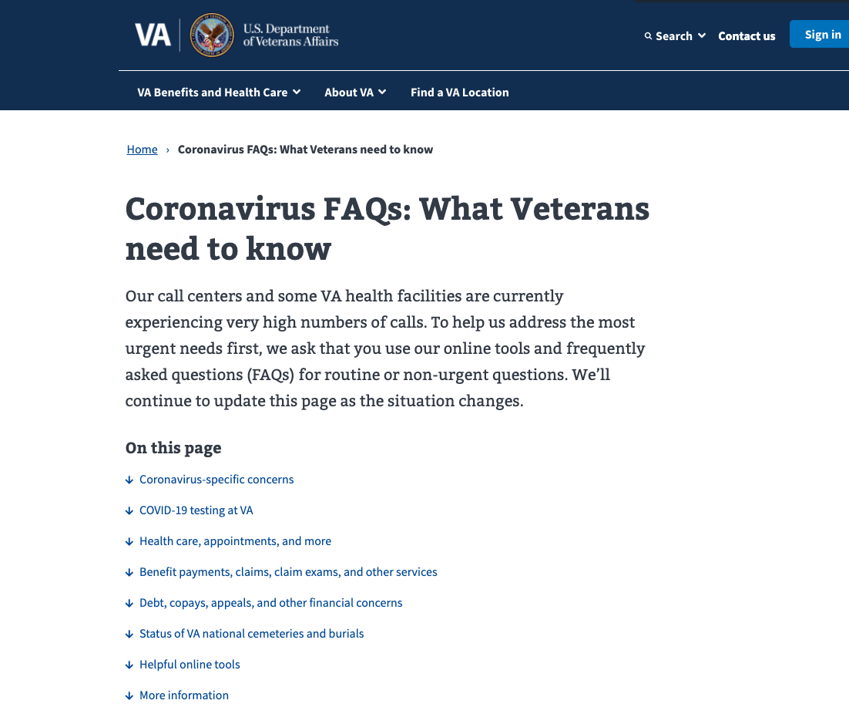

Corona FAQs Spanish Version Releasing ~1/20
Spanish*
http://www.va.gov/coronavirus-veteran-frequently-asked-questions-esp/
English*
https://www.va.gov/coronavirus-veteran-frequently-asked-questions/
First Corona/Covid page translated to Spanish
* Mocks for illustrative purposes

